Slide 1

Student Registration System
Team Members :
Konjac Huang
Pei Yi Chiang
Valen Chang
Daryl Foo
Kai Li Tan

Slide 2
Outline
Overview of the Student Database
Source of the Data and the Fields Contained in the Data set
Data Structures Used in the Project - Class Diagram
Results of the Walk-Throughs

Slide 3
Student Registration System
Allow Recording of Registered Students’ Information
Add New Data for New Students
Remove Students’ Information Once the Student Drops Out, Graduates or Transfers
Search for Specific Information of the Students
Display Information in the Database

Slide 4
Data Set
Data of some Student currently enrolled in De Anza College
Data of the Students were obtained through interviewing several students on campus
Data fields of Student include:
- Name
- Major
- Student ID
- Date of Birth
- Country of Origin

Slide 5
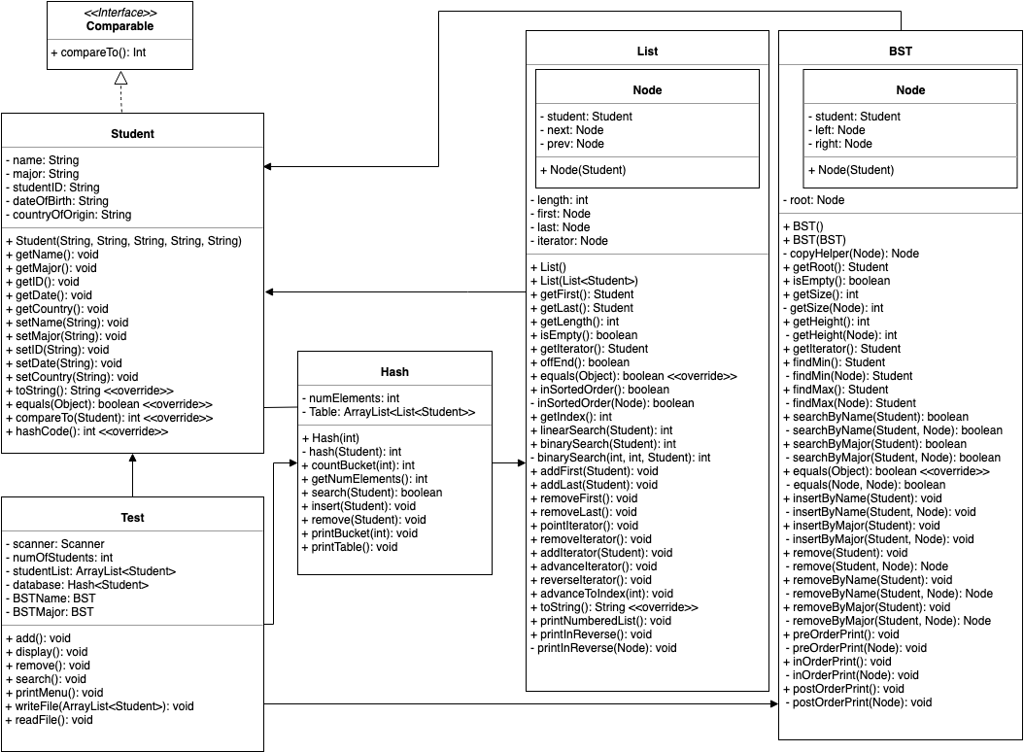
UML

Slide 6
Test Class
Unidirectional association towards Student class
  Creates an ArrayList of Student objects
Unidirectional association towards Hash class
  Creates a Hash Table of Student objects based on the key
Unidirectional association towards BST class
  Creates BST objects based on the primary key and the secondary key (BSTName and BSTMajor)
Student class
Implements Comparable interface
  compareTo(Student)
Bidirectional association with Hash class
  hashCode() in Student class and hash(Student) in Hash class communicate with each other
Data Structures

Slide 7
Data Structures
Hash class
Bidirectional association with Student class
Unidirectional association towards List class
  Creates an ArrayList of List of Student objects
List Class
Unidirectional association towards Student class
  Creates Student objects in Node class
BST Class
Unidirectional association towards Student class
Creates Student objects in Node class

Slide 8
Results of Walk-Through
Scenario 1: Add a student, display the database, and write to file
Scenario 2: Remove a student, display the database, and write to file
Scenario 3: Search for student, display the database, and write to file
Feedback 1: Did not handle invalid input for sub-choices
Feedback 2: When displaying sub-choices, “End of database” was displayed when an invalid input was entered when it should not have been displayed
As a result, we added input validation for the sub-choices and removed the “End of database” line

Slide 9
Live Demo
of Project

Slide 10


Questions?
If you have any questions regarding our project, feel free to ask us!

Slide 11
Thank you!

